Slide 1
2020-21 fafsa.gov Preview Presentation
Logo for Federal Student Aid, an Office of the U.S. Department of Education, Proud Sponsor of the American Mind, registered trademark
October 2019

Slide 2
Topics
Overview
Home view
Login view
Dependent Student with Parental Data view
Independent Student view
My FAFSA views
SAR view
FAFSA Corrections view
Auto-Zero EFC (skipping the remaining financial questions) view
Special Circumstances view
Special Circumstance – Unsubsidized Loan Only view
Homeless Circumstance view
Additional Resources

Slide 3
Overview
The 2020-21 fafsa.gov Preview Presentation provides screenshots that Financial Aid Professionals, mentors, and counselors can use as a guide for the 2020-21 fafsa.gov application. The screenshots and information provided can be used to create/modify presentations for professional trainings and high school nights.
The screenshots are intended to show the majority of the questions displayed in fafsa.gov; however, most students and/or parents are unlikely to need to answer all of the questions when completing their application.
The test data used in this presentation shows examples of what fafsa.gov will look like.

Slide 4
Overview (continued, part 1)
The 2020-2021 version of fafsa.gov will be available for applicants to use on October 1, 2019.
You can use the Web Demonstration site to preview 2020-2021 functionality beginning on September 30, 2019.

Slide 5
Overview (continued, part 2)
The following are key features of fafsa.gov:
Students and parents may begin, complete, and submit a new or renewal FAFSA form for the 2020–21 FAFSA processing cycle.
Students and parents who are eligible may use the IRS Data Retrieval Tool (IRS DRT) to electronically transfer federal tax return information into a FAFSA form.
Students and parents may be eligible to transfer their FAFSA information into their state aid application. Participating states include Iowa, Minnesota, Mississippi, New Jersey, New York, Pennsylvania, and Vermont.
Parents that have multiple students who need to file an application may be eligible to transfer their FAFSA information into a new application from the original student’s confirmation page.
Students will be able to view additional information about the schools they selected on their FAFSA form for easy comparison of schools.
New views and sections have been added in effort to sync fafsa.gov with the mobile app.
Students and parents can save an application from fafsa.gov and resume where they left off on the mobile app.

Slide 6
Home Title Card
Home view

Slide 7
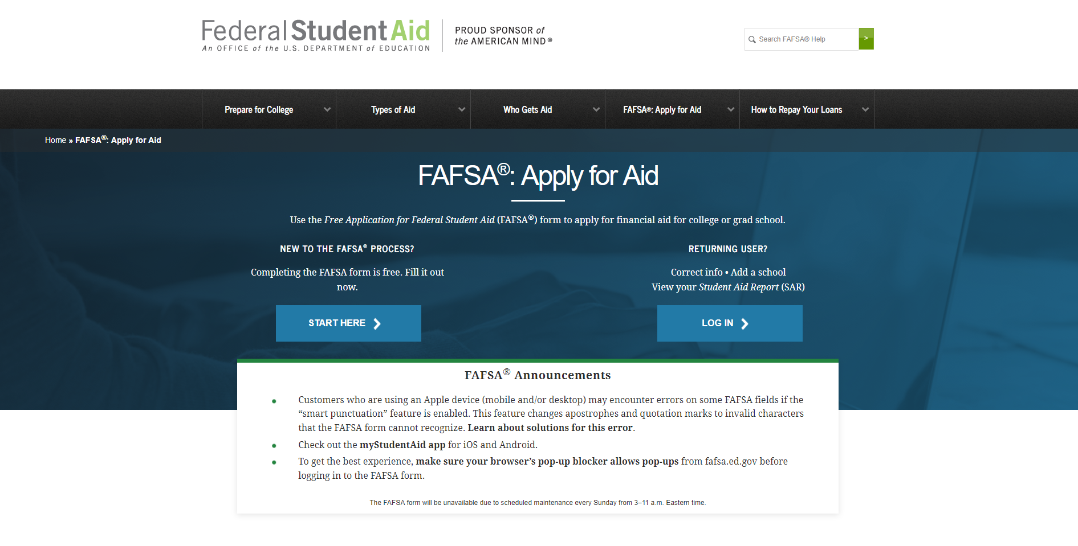
Home – Top Section
Notes:
2020-21 fafsa.gov home view. Top section of view.
The fafsa.gov home view features a two-button login option and current announcements, as well as an easy-access tool bar, featuring links to studentaid.gov and loan information.

Slide 8
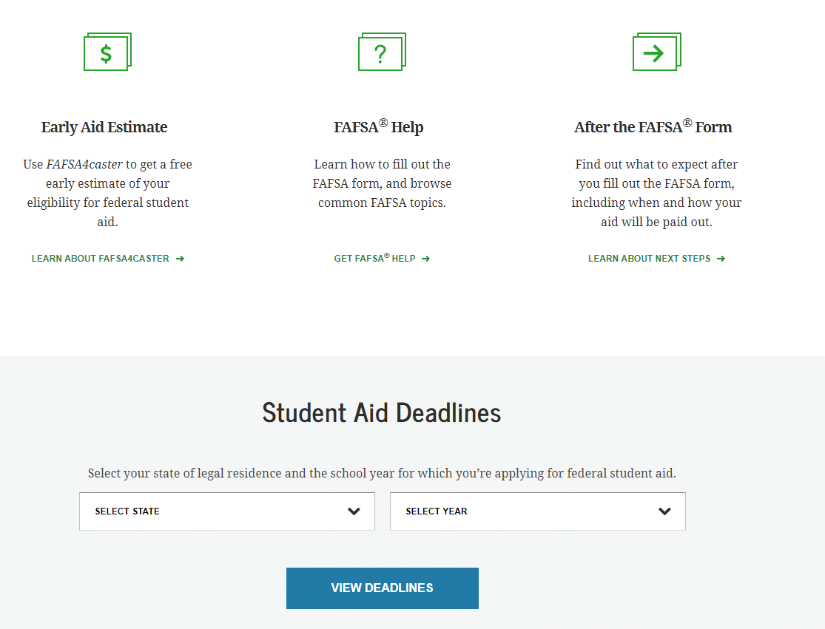
Home – Middle Section
Notes:
2020-21 fafsa.gov home view. Middle section of view.
The FAFSA home view features three links to help users navigate the financial aid process including FAFSA4caster, FAFSA help view, and FAFSA next steps once the form is completed.
A Student Aid deadline search function is available by state and cycle year.

Slide 9
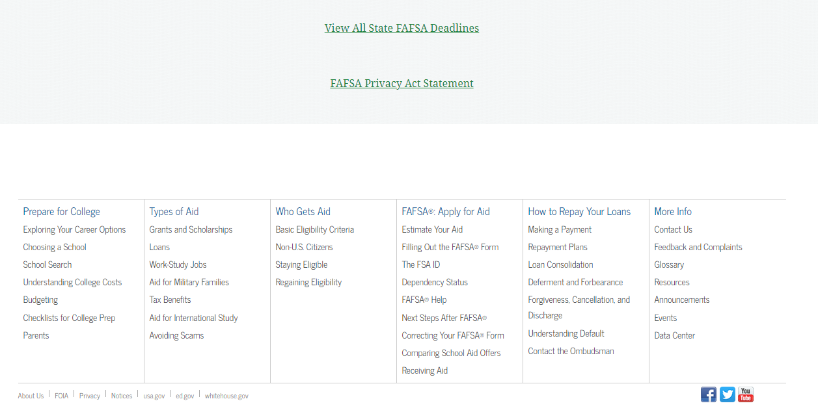
Home – Bottom Section
Notes:
2020-21 fafsa.gov home view. Bottom section of view.
Additional Student Aid links are provided at the bottom of the homepage.

Slide 10
Login Title Card
Login

Slide 11
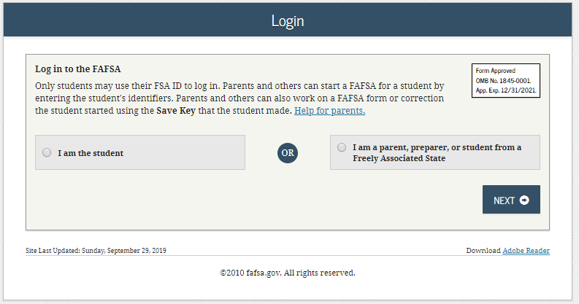
Login
Notes:
2020-21 “Login” view.

Slide 12
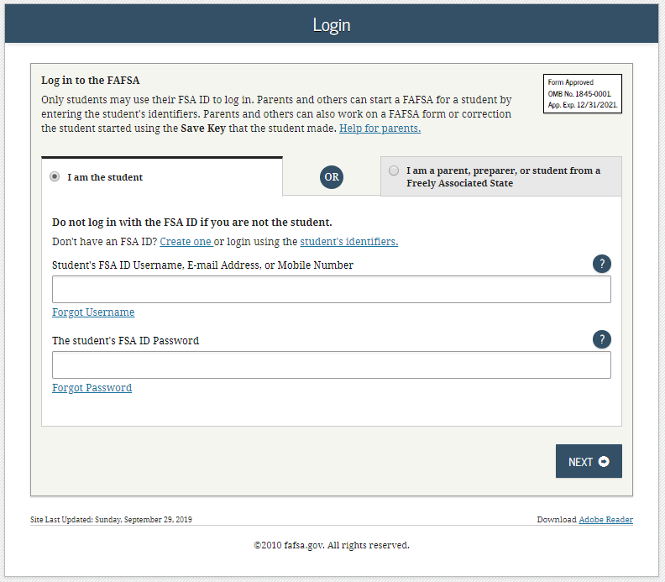
Login – I am the Student
Notes:
2020-21 “Login” view with the “I am the student” option selected.
Note: The user has the option to choose one of three ways to login to the application; using an FSA ID, a verified email address or a verified phone number.

Slide 13
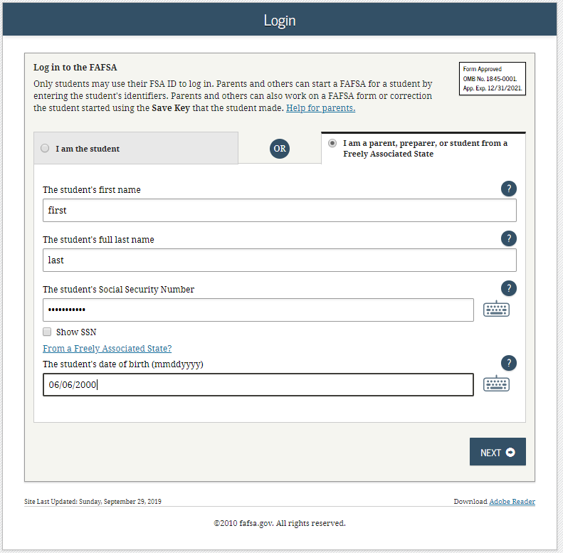
Login – I am the Parent, Preparer or Student from a Freely Associated State
Notes:
2020-21 “Login” view with the “I am a parent, preparer, or student from a Freely Associated State” option selected.
The SSN is now masked by default and users have the ability to check the “Show SSN” box if they wish to see what is being typed in.

Slide 14
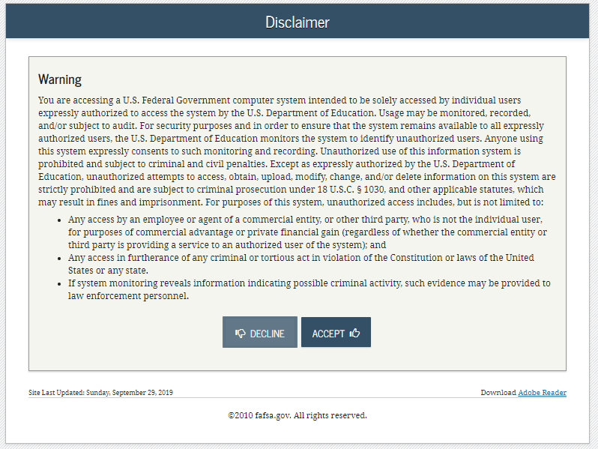
Disclaimer
Notes:
2020-21 “Disclaimer” view.

Slide 15
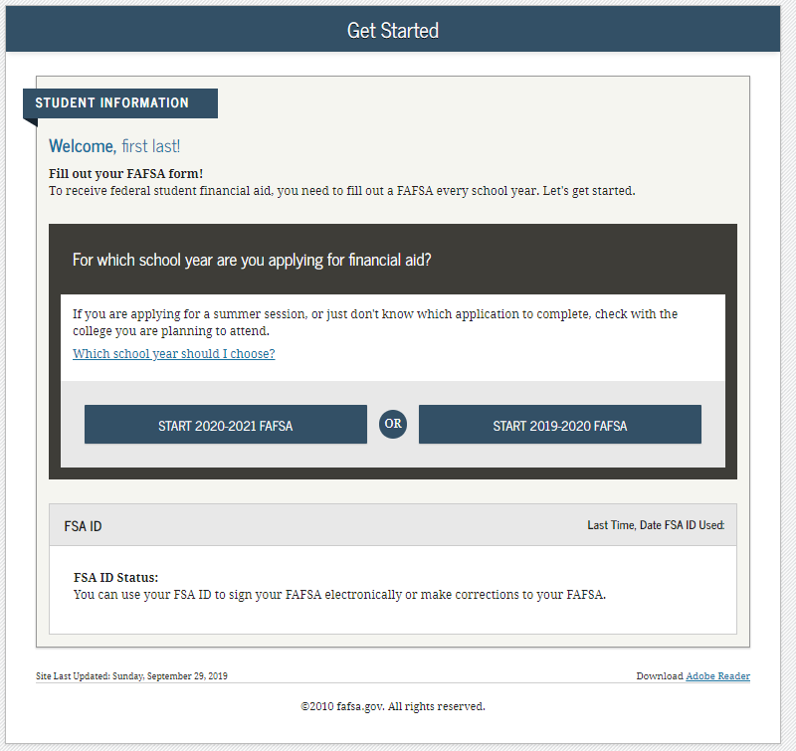
Get Started
Notes:
2020-21 “Get Started” view.

Slide 16
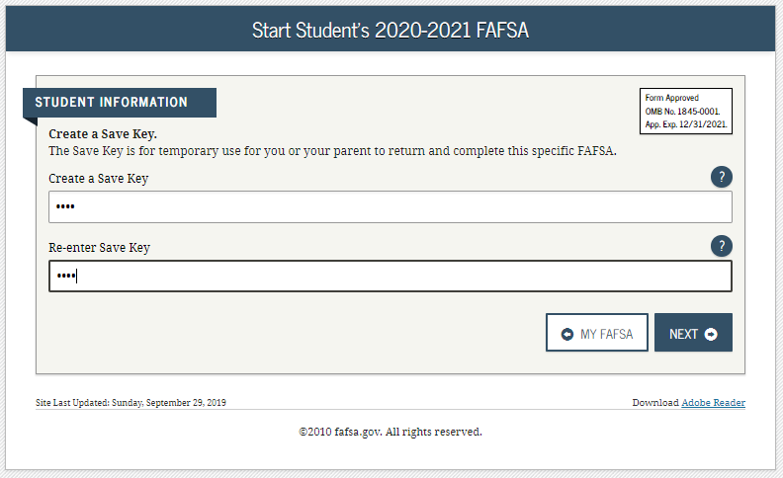
Create a Save Key
Notes:
2020-21 “Create a Save Key” view.
The “Save Key” allows an applicant to save their FAFSA application and return at a later time to complete and submit the application. The application is saved for 45 days, unless the student submits their application for processing prior to that. Additionally, the Save Key provides applicants a way to share access to their Free Application for Federal Student Aid (FAFSA®) application or correction if their parent(s) needs to add information or sign it.

Slide 17
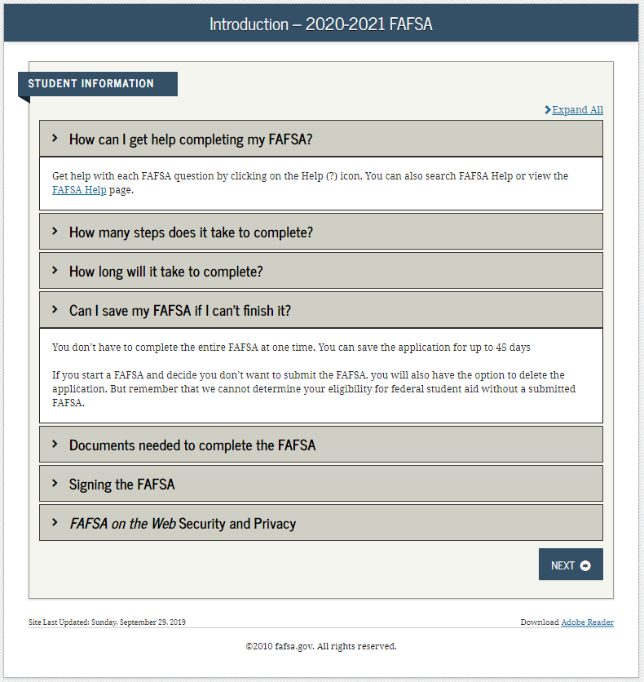
Introduction
Notes:
2020-21 “Introduction” view.
Each topic has accordion functionality that can be expanded and contracted to reveal additional information.

Slide 18
Dependent Student with Parental Data
Dependent Student with Parental Data
Notes:
Dependent Student with Parental Data – logged in as a student.

Slide 19
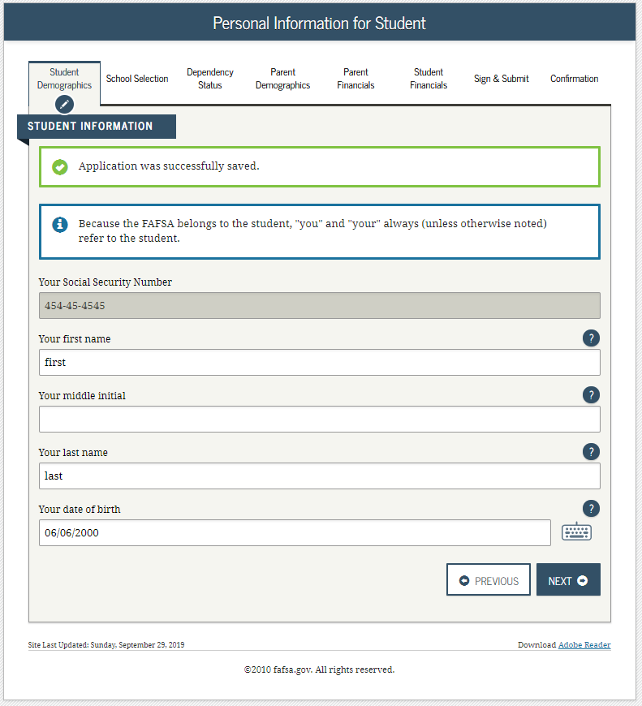
Personal Information for Student - Dependent
Notes:
2020-21 “Personal Information for Student” view.
This is one of multiple views on fafsa.gov that explains that ‘you’ and ‘your’ are referencing the student. Other views where this messaging appear include the Search for High School, Student Marital Status, Parent Marital Status and Student Tax Filing Status.
New views and sections, such as student financials, have been added to sync fafsa.gov with the mobile app. Examples of new “sync” views will be pointed out later on in the presentation.
Additional box highlighted in green indicating that the application has been successfully saved.
Note: This is the first view for the Student Demographics section.

Slide 20
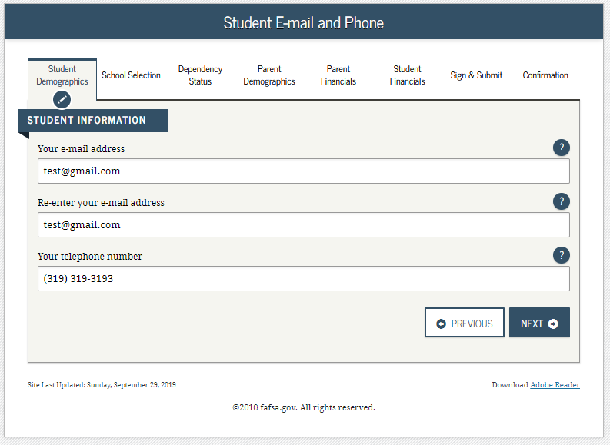
Student E-mail and Phone - Dependent
Notes:
2020-21 “Student E-mail and Phone” view.
This view is new to 2020-21, as email and phone are now on one page to sync fafsa.gov and the mobile app.
Note: While not mandatory, it is beneficial for the student/parent to include an e-mail address on the FAFSA application in order to receive important communications about their financial aid.

Slide 21
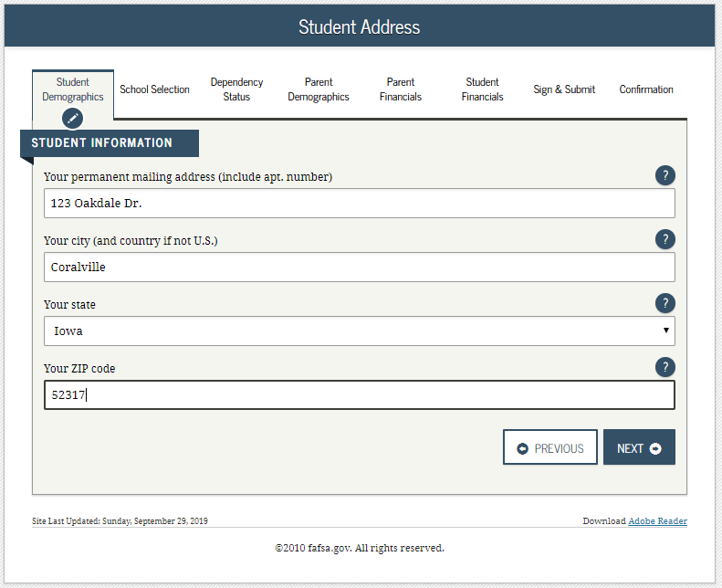
Student Address - Dependent
Notes:
2020-21 “Student Address” view.
Note: Email address is no longer on this page as it has been given it’s own page.

Slide 22
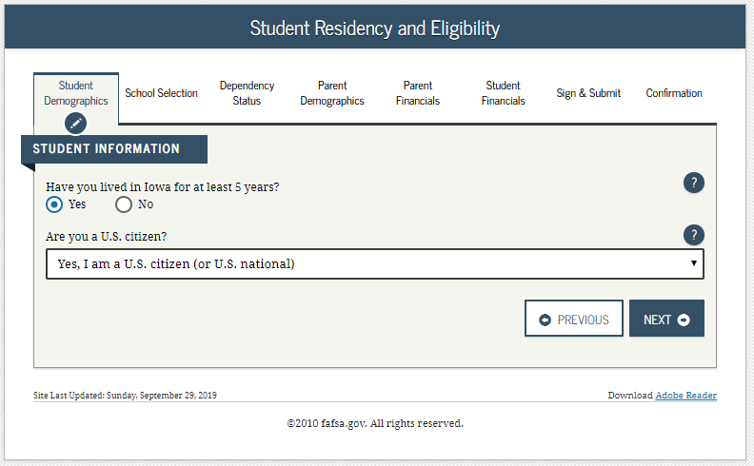
Student Residency and Eligibility - Dependent
Notes:
2020-21 “Student Residency and Eligibility” view.

Slide 23
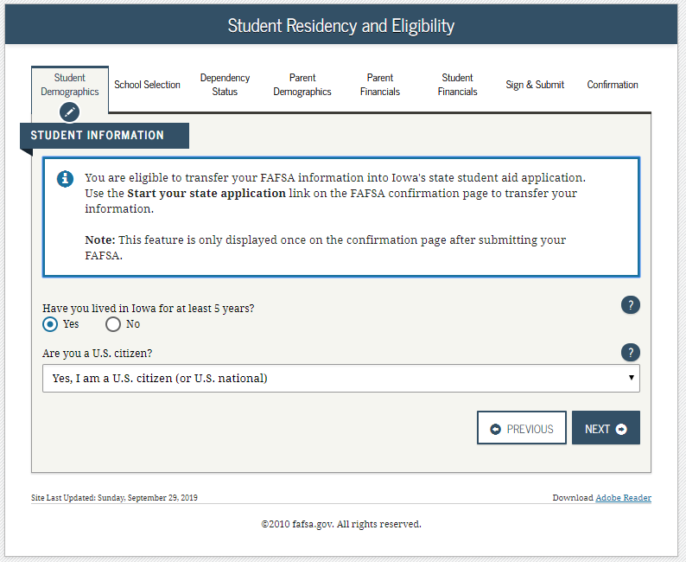
Student Residency and State Aid Eligibility - Dependent
Notes:
2020-21 “Student Residency and Eligibility” view.
The Informational message displays letting the applicant know they are eligible to transfer their FAFSA information to their participating state aid application and that the link will be available on the FAFSA confirmation view. This message will only display when the student indicates a participating state as their state of legal residence.
Participating states include: Iowa, Minnesota, Mississippi, New York, New Jersey, Pennsylvania, Vermont.

Slide 24
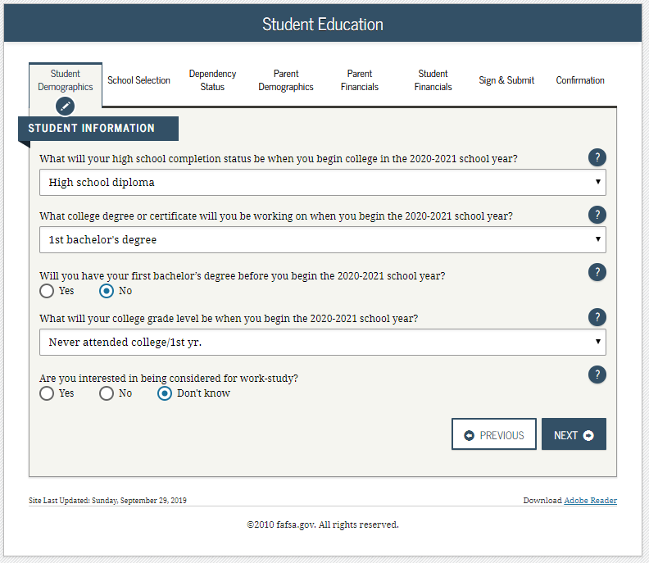
Student Education - Dependent
Notes:
2020-21 “Student Education” view.
Note: Question 30 has been updated to now include the word “college” in order to help applicants answer the question properly.

Slide 25
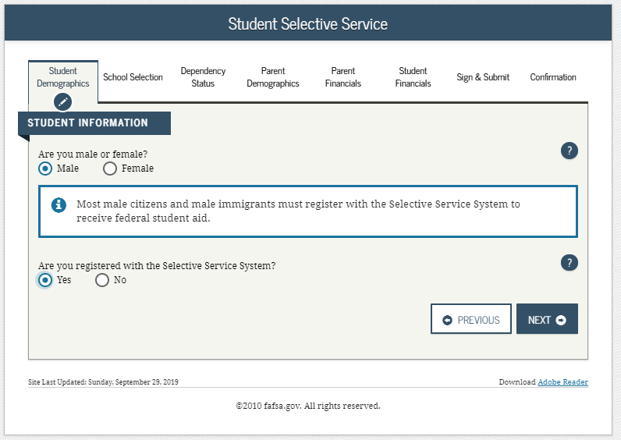
Student Selective Service - Dependent
Notes:
2020-21 “Student Selective Service” view.
This view is new to 2020-21, as the male/female and Selective Service questions are now on one page to sync fafsa.gov and the mobile app.

Slide 26
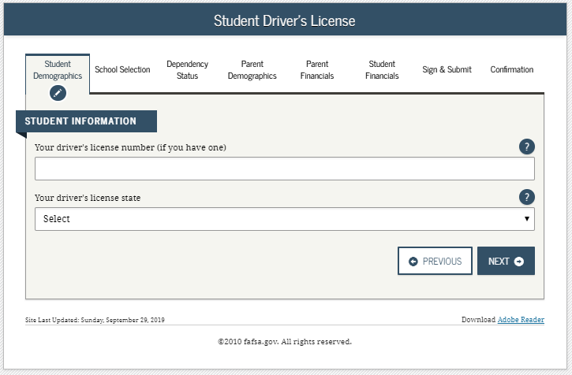
Student Driver’s License - Dependent
Notes:
2020-21 “Student Driver’s License” view.
This view is new to 2020-21, as driver’s license number and driver’s license state are now on one page to sync fafsa.gov and the mobile app.

Slide 27
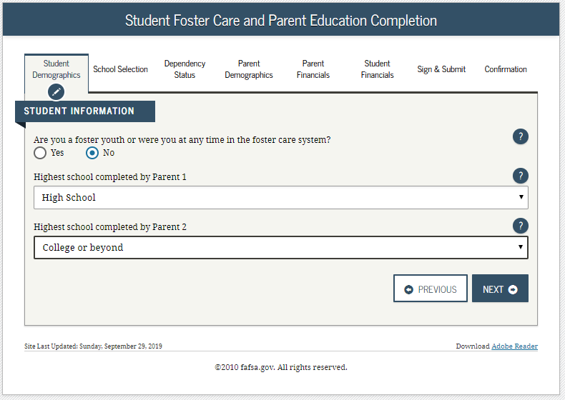
Student Foster Care/Parent Education Completion - Dependent
Notes:
2020-21 “Student Foster Care/Parent Education Completion” view.

Slide 28
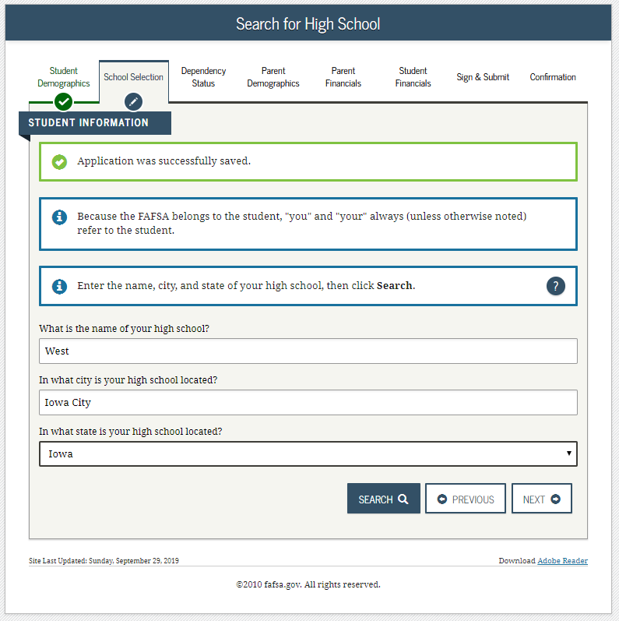
Search for High School - Dependent
Notes:
2020-21 “Search for High School” view.
Note: This is the first view for the School Selection section.

Slide 29
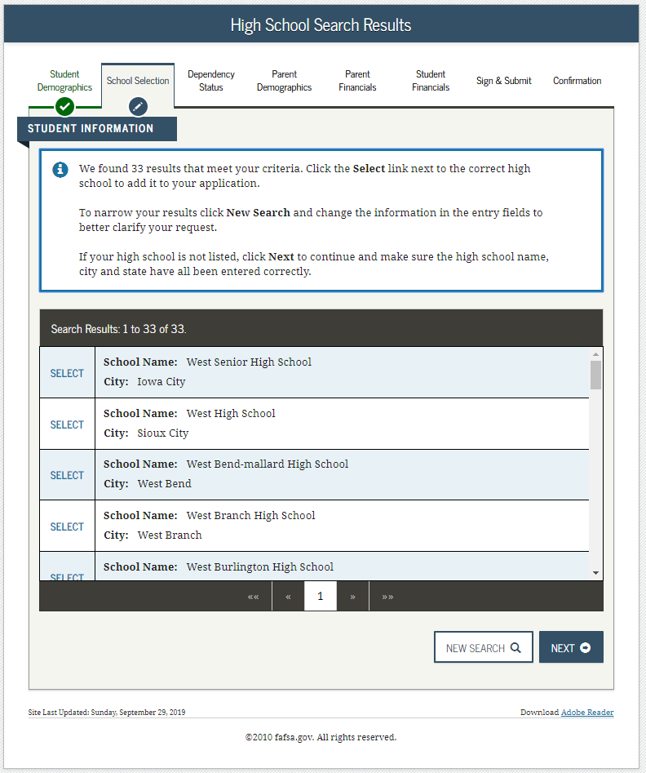
Search for High School Results - Dependent
Notes:
2020-21 “Search for High School Results” view.

Slide 30
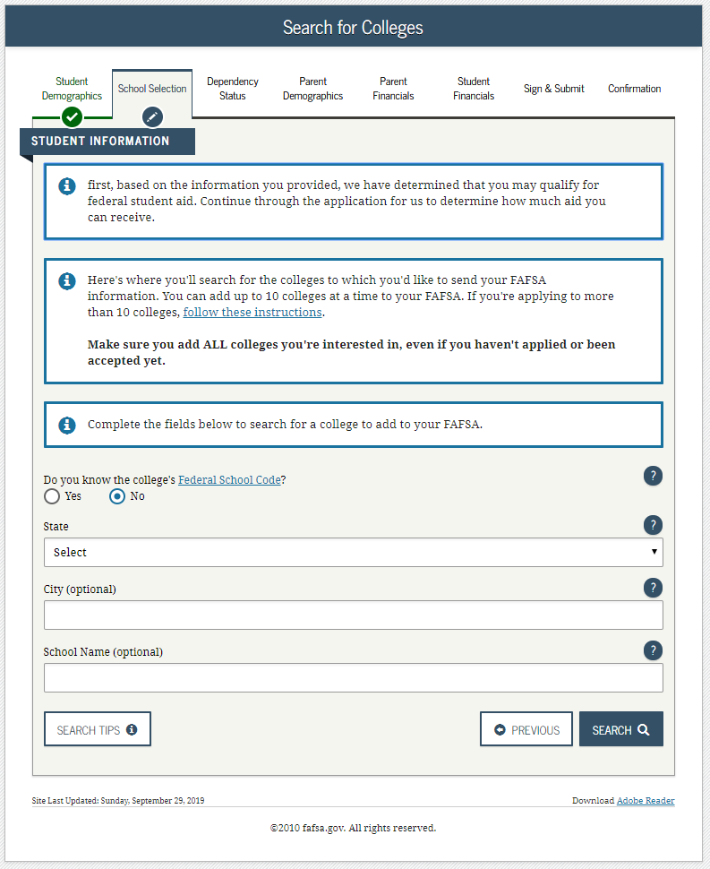
Search for Colleges - Dependent
Notes:
2020-21 “Search for Colleges” view.

Slide 31
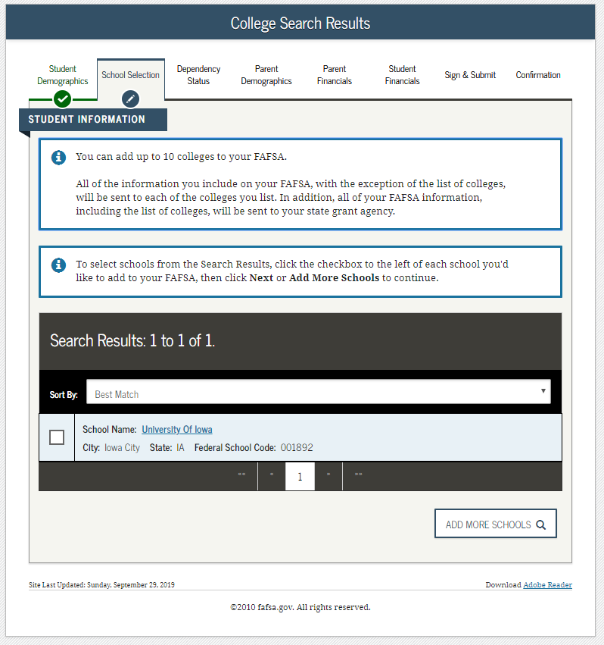
College Search Results - Dependent
Notes:
2020-21 “College Search Results” view.

Slide 32
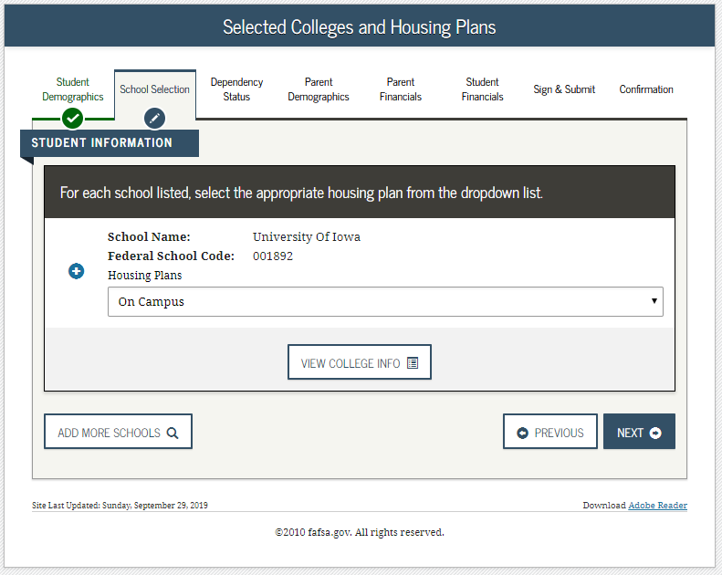
Selected Colleges and Housing Plans - Dependent
Notes:
2020-21 “Selected Colleges and Housing Plans” view.

Slide 33
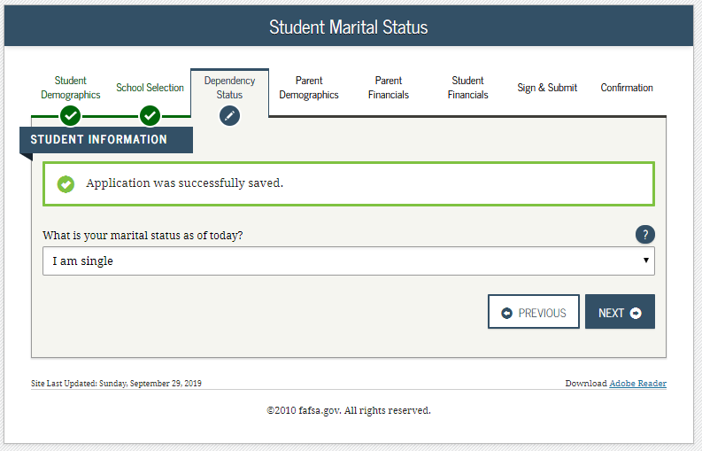
Student Marital Status - Dependent
Notes:
2020-21 “Student Marital Status” view.
Note: This is the first view of the Dependency Status section, this view is also a new view in order to sync fafsa.gov and the mobile app.

Slide 34
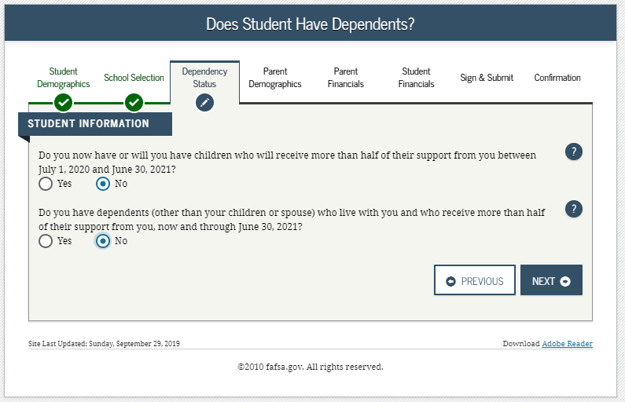
Does Student Have Dependents? - Dependent
Notes:
2020-21 “Does Student Have Dependents?” view.

Slide 35
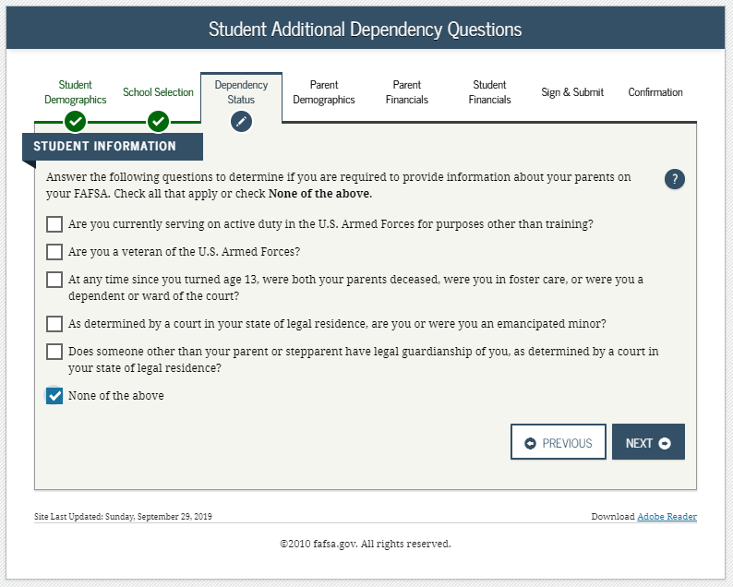
Student Additional Dependency Questions - Dependent
Notes:
2020-21 “Student Additional Dependency Questions” view.

Slide 36
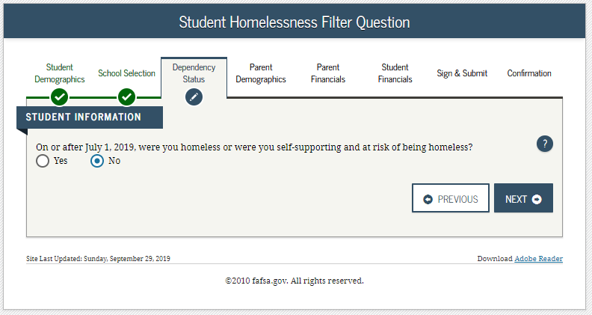
Student Homelessness Filter Question - Dependent
Notes:
2020-21 “Student Homelessness Filter Question” view.

Slide 37
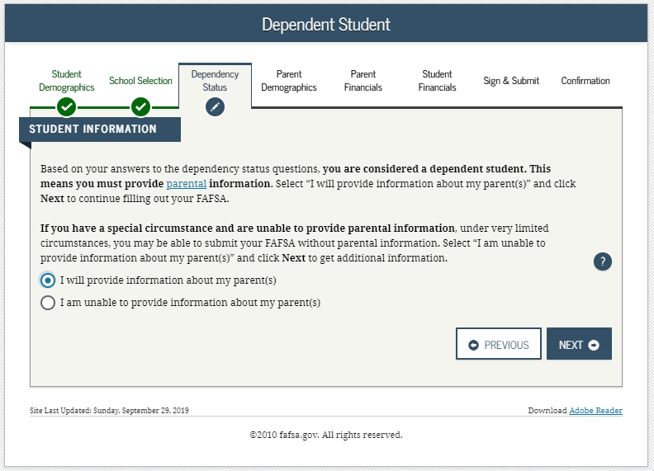
Dependent Student Determination - Dependent
Notes:
2020-21 “Dependent Student” view.
This view only displays if the applicant has been determined to be dependent.

Slide 38
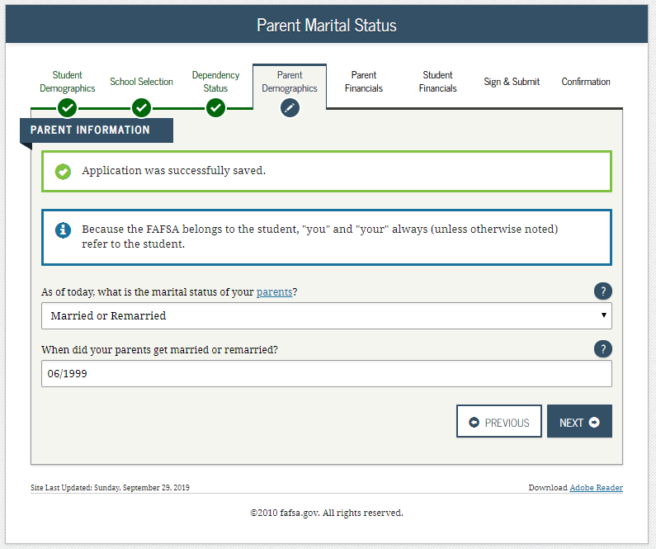
Parent Marital Status - Dependent
Notes:
2020-21 “Parent Marital Status” view.
Note: This is the first view in the Parent Demographics section.

Slide 39
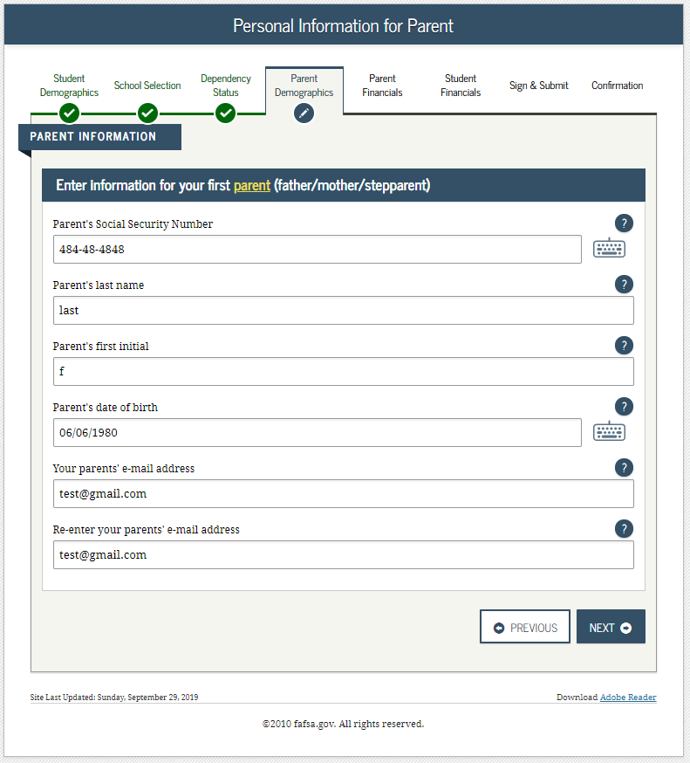
Personal Information for Parent - Dependent
Notes:
2020-21 “Personal Information for Parent” view.
Parent e-mail is now a part of the information page instead of its own page.

Slide 40
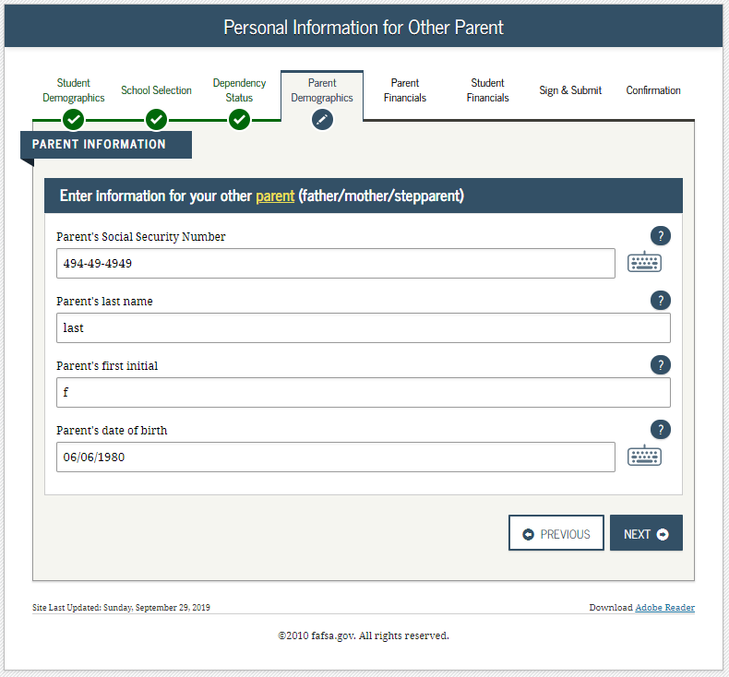
Personal Information for Other Parent - Dependent
Notes:
2020-21 “Personal Information for Other Parent” view.

Slide 41
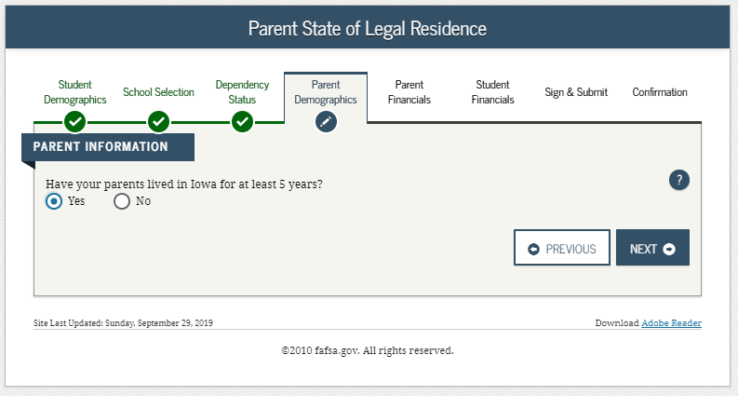
Parent State of Legal Residence - Dependent
Notes:
2020-21 “Parent State of Legal Residence” view.

Slide 42
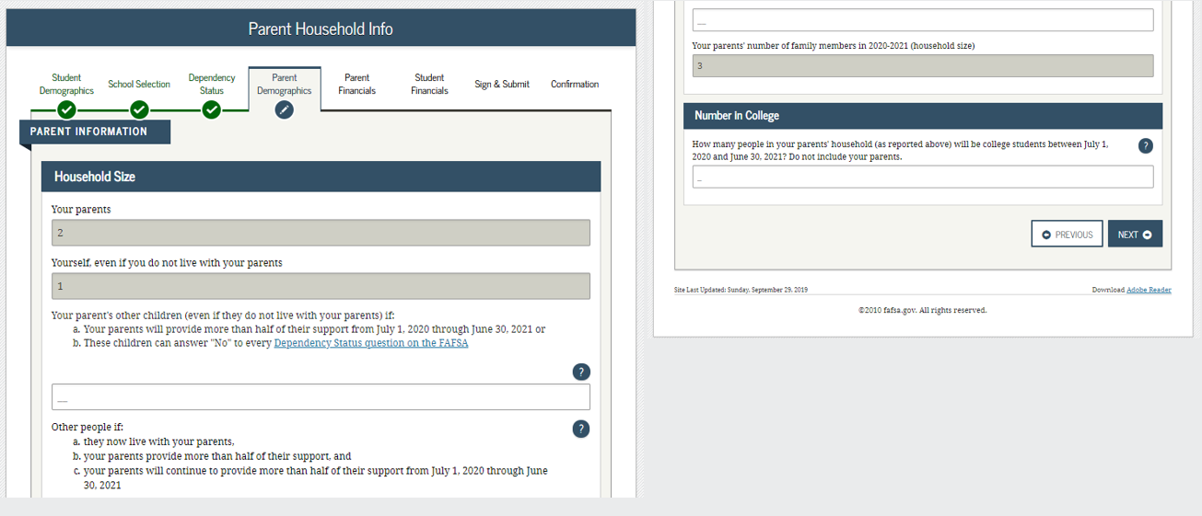
Parent Household Info - Dependent
Notes:
2020-21 “Parent Household Info” view.
Parents are required to complete the household size worksheet in an effort to get more accurate information about the number in the parent’s household and the number of those in the household who are in college. Some information will be prefilled, based on responses provided previously within the FAFSA form. The system tallies the totals as the parent completes the worksheet to ensure that there are no mathematical errors.

Slide 43
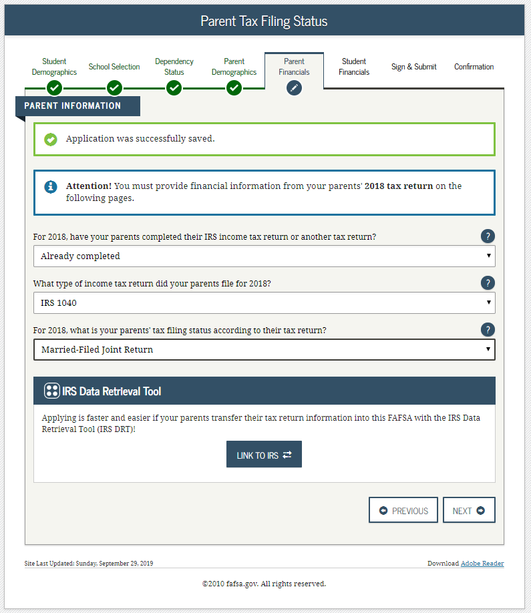
Parent Tax Filing Status – Dependent
Notes:
2020-21 “Parent Tax Filing Status” view.
The tax return type dropdown question is now displayed on this page.
Note: This is the first view in the Parent Financials section.

Slide 44
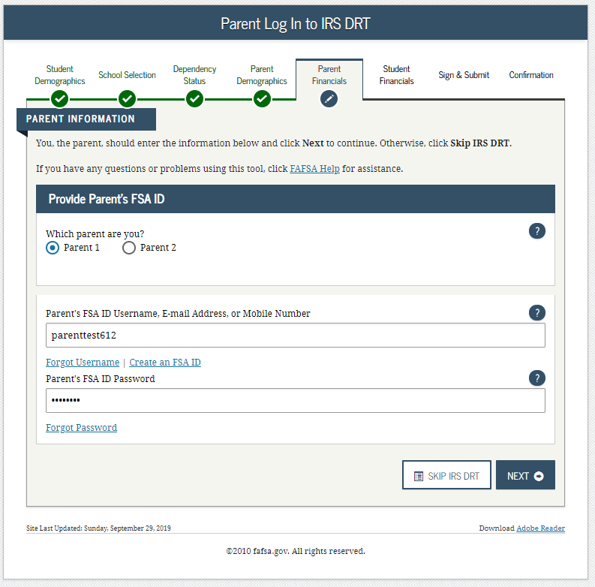
Parent Log In to the IRS DRT - Dependent
Notes:
2020-21 “Parent Log In to the IRS DRT” view.

Slide 45
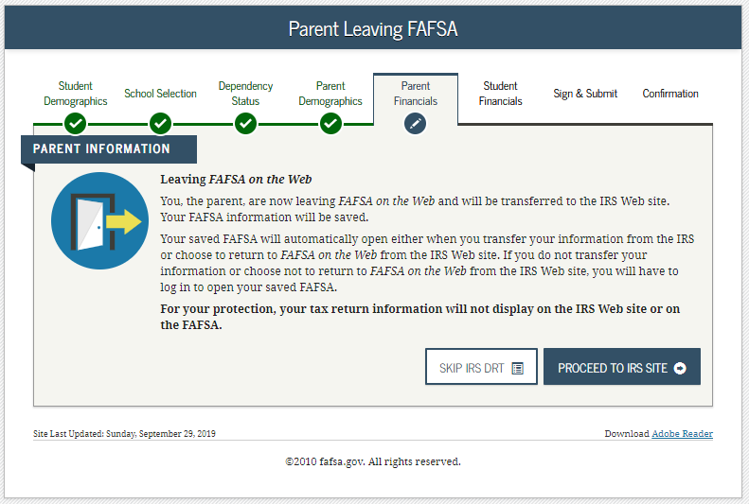
Parent Leaving FAFSA - Dependent
Notes:
2020-21 “Parent Leaving FAFSA” view.

Slide 46
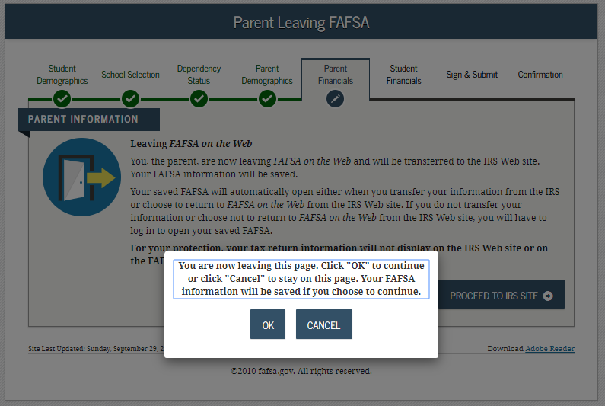
You Are Now Leaving This Page - Dependent
Notes:
2020-21 “ You Are Now Leaving This Page” view.

Slide 47
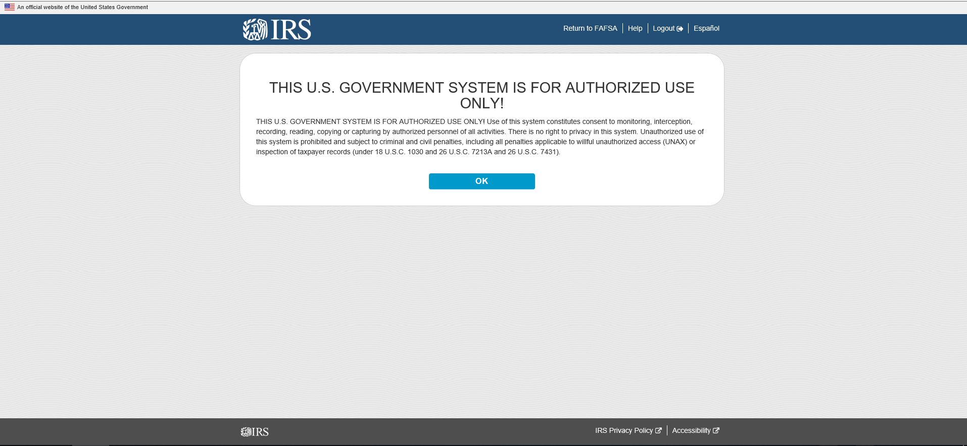
Disclaimer, Parent – IRS Site
Notes:
20-21 “IRS Site Disclaimer” view.

Slide 48
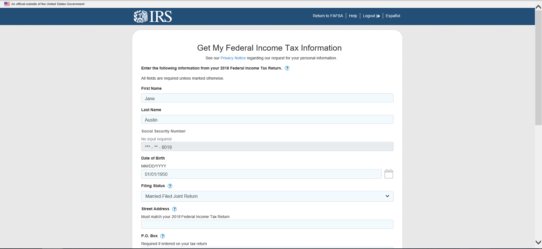
Personal Information, Top Section, Parent – IRS Site
Notes:
This is the first half of the Personal Information view.

Slide 49
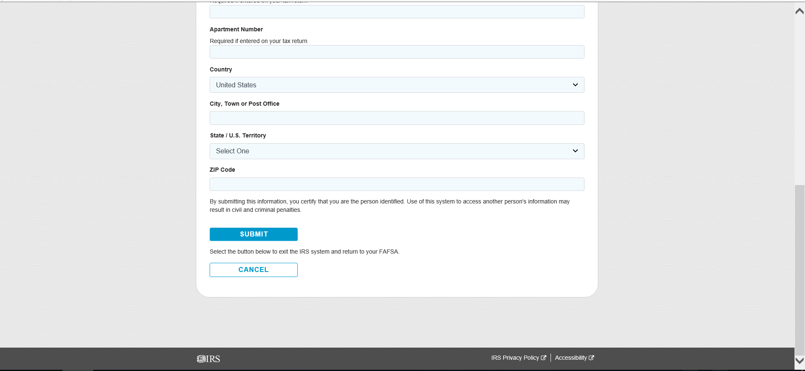
Personal Information, Bottom Section, Parent – IRS Site
Notes:
This is the Second half of the Personal Information view.

Slide 50
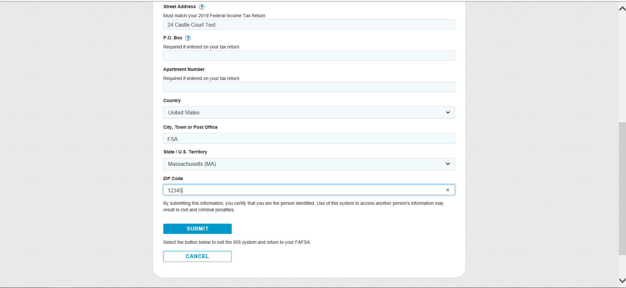
Parent Address, Parent – IRS Site
Notes:
Added parent address

Slide 51
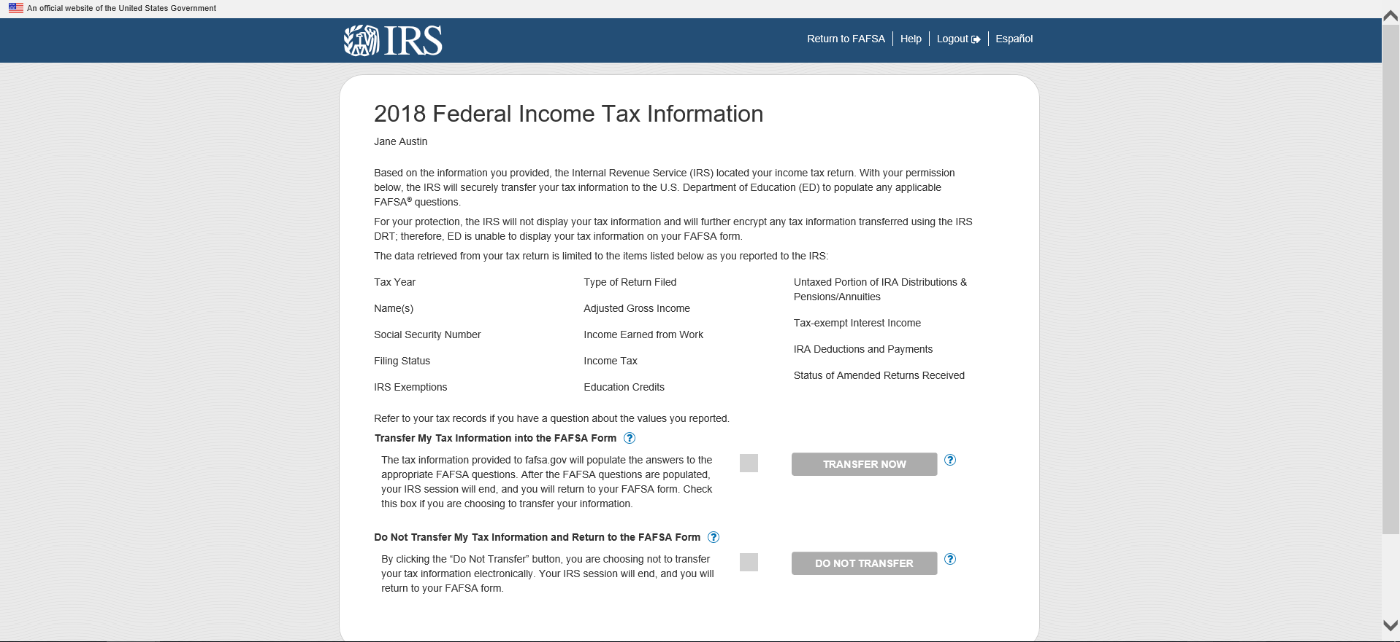
Results Page, Top Section, Parent – IRS Site
Notes:
First Half of the Results Page

Slide 52
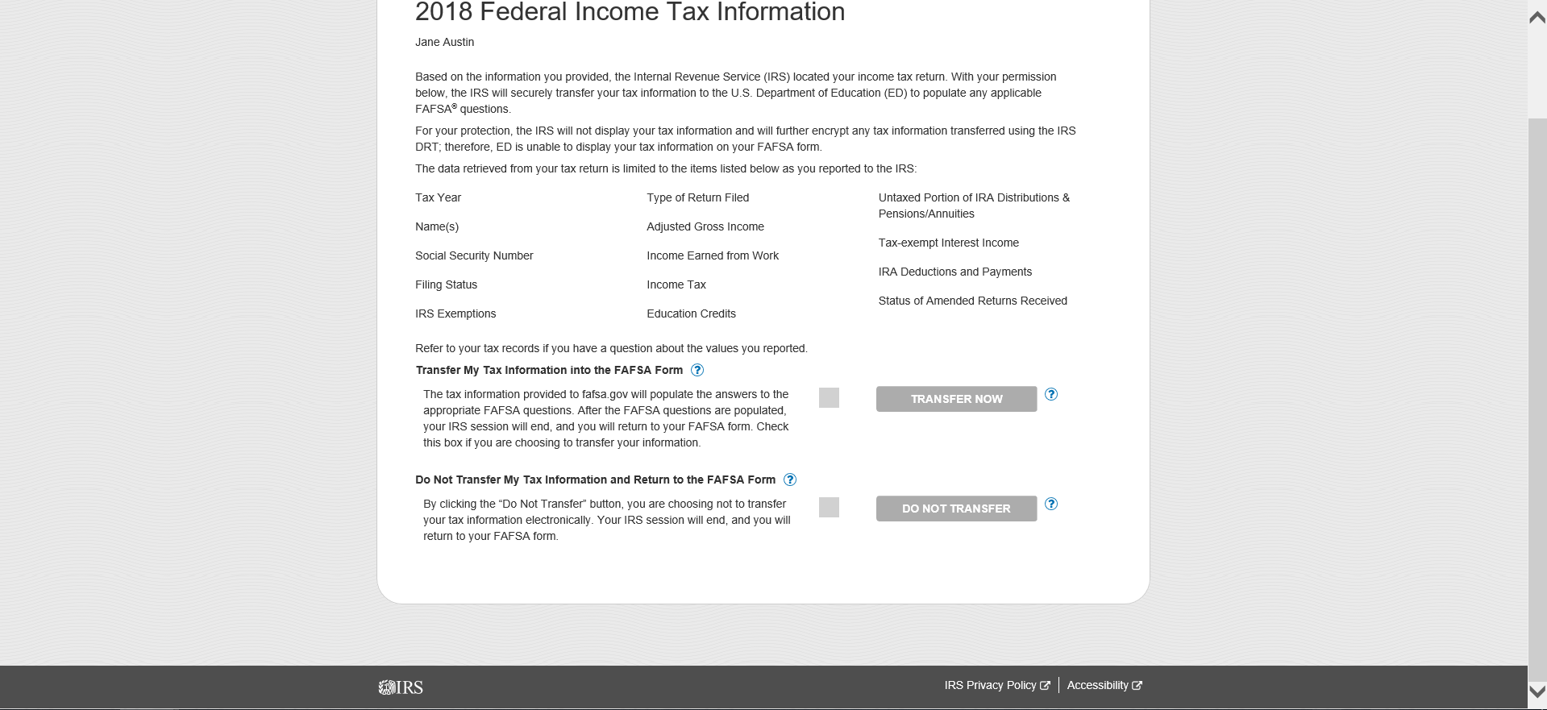
Results Page , Bottom Section, Parent – IRS Site
Notes:
Second Half of the Results Page

Slide 53
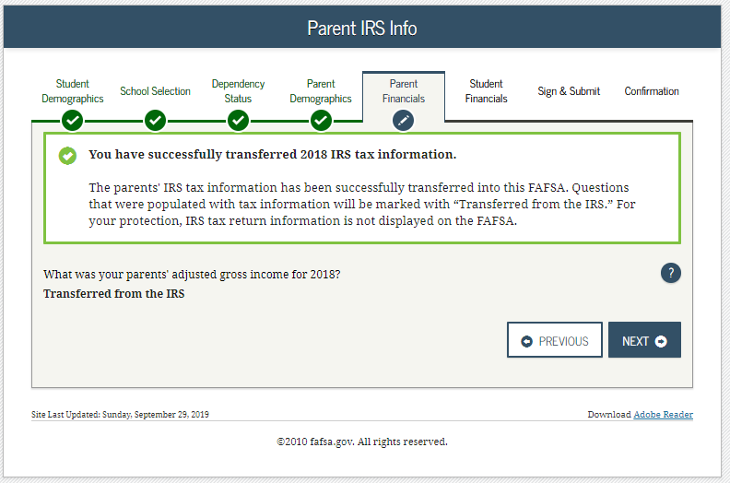
Parent IRS Info - Dependent
Notes:
2020-21 “Parent IRS Info” view.
A text box is displayed outlined in green indicating that the IRS Data was successfully transferred and will be identified as “Transferred from the IRS.”

Slide 54
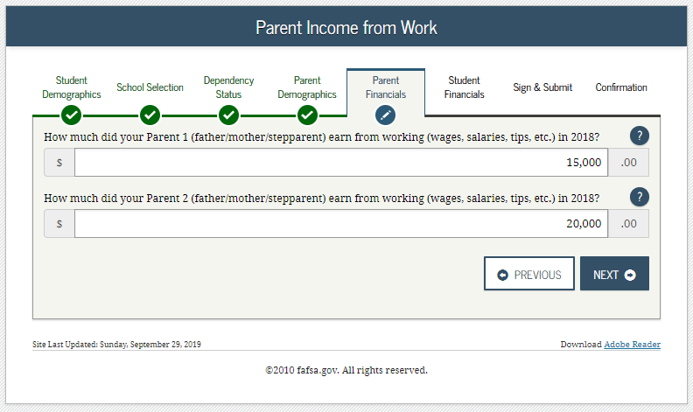
Parent Income from Work – Dependent
Notes:
2020-21 “Parent Income from Work” view.

Slide 55
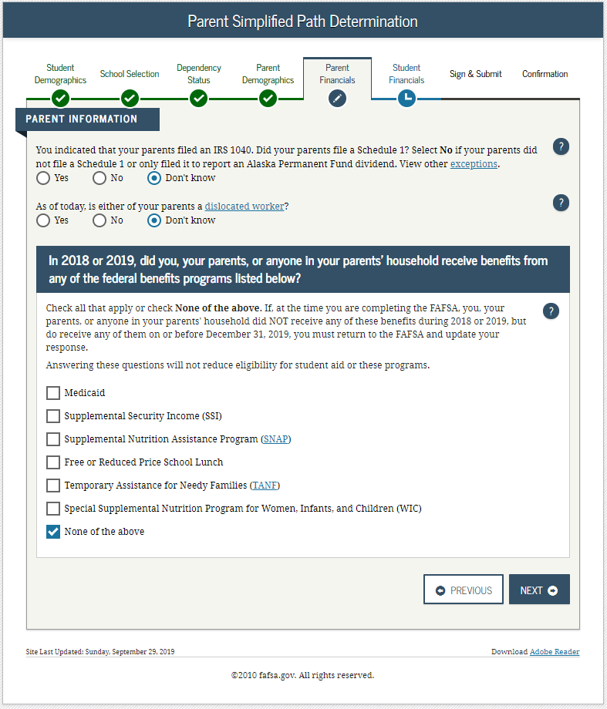
Parent Simplified Path Determination - Dependent
Notes:
2020-21 “Parent Simplified Path Determination” view.
This page has been updated for the 2020-21 cycle to replace the previous “Eligible to file 1040A/EZ” question with the new “Filed Schedule 1” question.
Note: Additional instructional text has been added to the schedule 1 question. The instructional text will be dynamic based on the response to Parent Tax Return Status. In this example the parent stated they “already filed” and “filed a 1040” in order to create the condition for schedule 1 dynamic text to display.

Slide 56
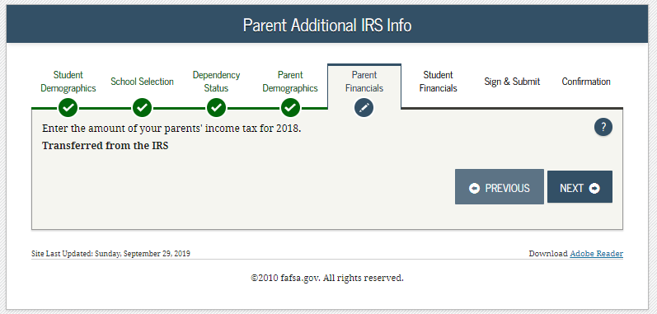
Parent Additional IRS Info - Dependent
Notes:
2020-21 “Parent Additional IRS Info” view.

Slide 57
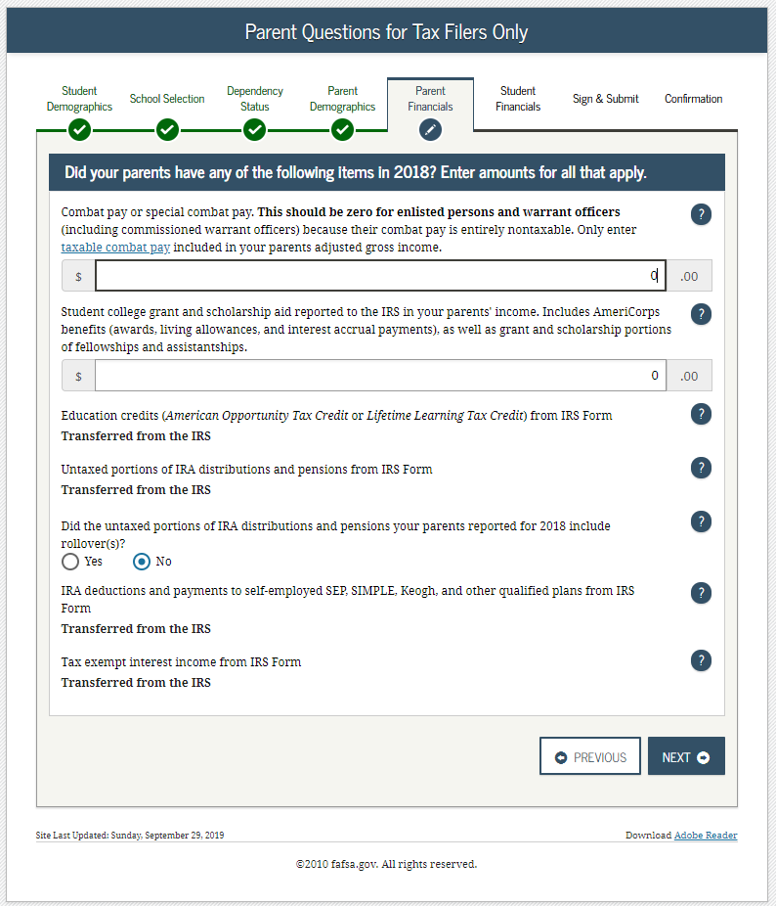
Parent Questions for Tax Filers Only – Dependent
Notes:
2020-21 “Parent Questions for Tax Filers Only” view.
Note: Additional instructional text has been added to help students and parents answer the combat pay question correctly.

Slide 58
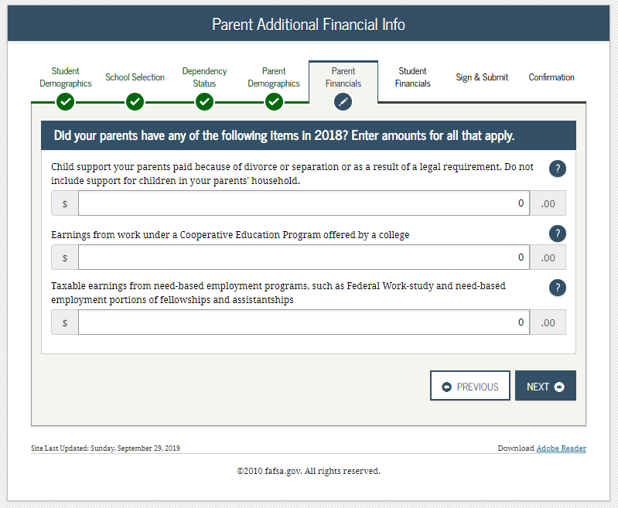
Parent Additional Financial Info - Dependent
Notes:
2020-21 “Parent Additional Financial Info” view.

Slide 59
Parent Untaxed Income - Dependent
Notes:
2020-21 “Parent Untaxed Income” view.

Slide 60
Parent Assets - Dependent
Notes:
2020-21 “Parent Assets” view.

Slide 61
Student Tax Filing Status - Dependent
Notes:
2020-21 “Student Tax Filing Status” view.
“Type of Tax Return” question has been moved from the “Student IRS Info” view and added to this view.
Note: This if first view of the Student Financials section.

Slide 62
Student Log In to IRS DRT - Dependent
Notes:
2020-21 “Student Log In to IRS DRT” view, displayed when the student is going to the IRS Web site.
In this instance the student is required to provide their FSA ID and password to get to the IRS DRT because the parent started the application by entering the student’s identifiers.

Slide 63
Student Leaving FAFSA - Dependent
Notes:
2020-21 “Student Leaving FAFSA” view.

Slide 64
Leaving FAFSA pop-up - Dependent
Notes:
2020-21 “Leaving FAFSA pop-up” view, displayed when the student is going to the IRS Web site.

Slide 65
Disclaimer, Student – IRS Site
Notes:
IRS DRT Disclaimer view.

Slide 66
Personal Information, Top Section, Student - IRS Site
Notes:
This is the first half of the Personal Information view.

Slide 67
Personal Information , Bottom Section, Student – IRS Site
Notes:
This is the Second half of the Personal Information view.

Slide 68
Student Address, Student – IRS Site
Notes:
Added student address.

Slide 69
Results Page, Top Section, Student – IRS Site
Notes:
First Half of the Results Page.

Slide 70
Results Page , Bottom Section, Student – IRS Site
Notes:
Second Half of the Results Page.

Slide 71
Student IRS Info - Dependent
Notes:
2020-21 “Student IRS Info” view.
An alert message will indicate that the IRS Data was successfully transferred and will be identified as “Transferred from the IRS.”

Slide 72
Student Income from Work - Dependent
Notes:
2020-21 “Student Income from Work” view.

Slide 73
Student Additional IRS Info - Dependent
Notes:
2020-21 “Student Additional IRS Info” view.

Slide 74
Student Questions for Tax Filers Only - Dependent
Notes:
2020-21 “Student Questions for Tax Filers Only” view.
Note: Additional instructional text has been added to help students and parents answer the combat pay question correctly.

Slide 75
Student Additional Financial Info - Dependent
Notes:
2020-21 “Student Additional Financial Info” view.

Slide 76
Student Untaxed Income - Dependent
Notes:
2020-21 “Student Untaxed Income” view.

Slide 77
Student Assets - Dependent
Notes:
2020-21 “Student Assets” view.

Slide 78
Preparer Info - Dependent
Notes:
2020-21 “Preparer Info” view.
Note: This is the first view of Sign & Submit section.

Slide 79
FAFSA Summary - Student Demographics and School Selection - Dependent
Notes:
2020-21 “FAFSA Summary” view – Student Demographics and School Selection.

Slide 80
FAFSA Summary - Dependency Status, Parent Demographics and Parent Financials - Dependent
Notes:
2020-21 “FAFSA Summary” view – Dependency Status, Parent Demographics and Parent Financials.

Slide 81
FAFSA Summary - Parent Financials Continued, Student Financials, Sign & Submit - Dependent
Notes:
2020-21 “FAFSA Summary” view – Parent Financials Continued, Student Financials, Sign & Submit.

Slide 82
FAFSA Summary - Student Financials, Sign & Submit - Dependent
Notes:
2020-21 “FAFSA Summary” view – Student Financials, Sign & Submit.

Slide 83
Signature Status – Dependent
Notes:
2020-21 “Signature Status” view.
This is where the applicant signs and actively acknowledges the Certification Statement.

Slide 84
Agreement of Terms, Student - Dependent
Notes:
2020-21 “Agreement of Terms” student view.

Slide 85
Signature Options, Student - Dependent
Notes:
2020-21 “Signature Options” view.

Slide 86
Signature Status, Student Signature Accepted - Dependent
Notes:
2020-21 “Signature Status” view.
Student signature accepted, and now the parent will need to sign.

Slide 87
Which Parent Signs - Dependent
Notes:
2020-21 “Which Parent Signs” view.
Allows the user to select which parent will be signing the application.
The choice between parents is only present if information was provided for two parents. Otherwise, this view doesn't display.

Slide 88
Agreement of Terms, Parent - Dependent
Notes:
2020-21 “Agreement of Terms” view for parent.

Slide 89
Signature Options, Parent - Dependent
Notes:
2020-21 “Signature Options” view for parent.
FSA does not “collect” the FSA ID if it was already provided to use the parent IRS DRT.

Slide 90
Signature Status, Parent Signature Accepted - Dependent
Notes:
2020-21 “Signature Status” view.
Shows both student and parent signatures have been accepted.

Slide 91
Confirmation Page - Dependent
Notes:
2020-21 “Confirmation Page” view.
Parents of students are offered the option to transfer some of the student information and start a state aid application. In this instance the student can start an Iowa State Aid application.
Parents of students are offered the option to transfer the parents’ data into another student’s new FAFSA by clicking the blue box saying “Does your brother or sister need to complete a FAFSA?”
If the applicant leaves the confirmation view before they click this link, they will not be able to return to transfer data to the application of a sibling.
User has the option to start their state aid application if they are a resident of one of the participating states (Iowa, Minnesota, Mississippi, New York, New Jersey, Pennsylvania, Vermont).

Slide 92
Independent Student
Independent Student

Slide 93
Login - Independent
Notes:
2020-21 “Login” view.

Slide 94
Disclaimer - Independent
Notes:
2020-21 “Disclaimer” view.

Slide 95
Get Started - Independent
Notes:
2020-21 “Get Started” view.
The applicant can view the status of their FSA ID in the FSA ID section of the “Get Started” view.

Slide 96
Create a Save Key - Independent
Notes:
2020-21 “Create a Save Key” view.
The “Save Key” allows an applicant to save their FAFSA application and return at a later time to complete and submit the application. The application is saved for 45 days, unless the student submits their application for processing prior to that. Additionally, the Save Key provides applicants a way to share access to their Free Application for Federal Student Aid (FAFSA®) application or correction if their parent(s) needs to add information or sign it.

Slide 97
Introduction - Independent
Notes:
2020-21 “Introduction” view.
Each topic has accordion functionality that can be expanded and contracted to reveal additional information.

Slide 98
Personal Information for Student - Independent
Notes:
2020-21 “Personal Information for Student” view.
This is one of multiple views on fafsa.gov that explains that ‘you’ and ‘your’ are referencing the student. Other views where this messaging appear include the Search for High School, Student Marital Status, Parent Marital Status and Student Tax Filing Status
Additional box highlighted in green indicating that the application has been successfully saved.
Note: This is the first view of the Student Demographics section.

Slide 99
Student E-mail and Phone - Independent
Notes:
2020-21 “Student E-mail and Phone” view.
This view is new to 2020-21, as email and phone are now on one page to sync fafsa.gov and the mobile app.
Note: While not mandatory, it is beneficial for the student/parent to include an e-mail address on the FAFSA application in order to receive important communications about their financial aid.

Slide 100
Student Address - Independent
Notes:
2020-21 “Student Address” view.
Note: Email address is longer on this page as it has been given it’s own page.

Slide 101
Student Residency and Eligibility - Independent
Notes:
2020-21 “Student Residency and Eligibility” view.
The Informational message displays letting the applicant know they are eligible to transfer their FAFSA information to their participating state aid application and that the link will be available on the FAFSA confirmation view. This message will only display when the student indicates a participating state as their state of legal residence.
Participating states include: Iowa, Minnesota, Mississippi, New York, New Jersey, Pennsylvania, Vermont.

Slide 102
Student Education - Independent
Notes:
2020-21 “Student Education” view.
Note: Question 30 has been updated to now include the word “college” in order to help applicants answer the question properly.

Slide 103
Student Selective Service - Independent
Notes:
2020-21 “Student Selective Service” view.
This view is new to 2020-21, as gender and Selective Service are now on one page to sync fafsa.gov and the mobile app. In this instance the student is female, so the Selective Service question will not appear.

Slide 104
Student Driver’s License - Independent
Notes:
2020-21 “Student Driver’s License” view.
This view is new to 2020-21, as driver’s license number and driver’s license state are now on one page to sync fafsa.gov and the mobile app.

Slide 105
Student Foster Care/Parent Education Completion - Independent
Notes:
2020-21 “Student Foster Care/Parent Education Completion” view.

Slide 106
Search for High School - Independent
Notes:
2020-21 “Search for High School” view.
Note: This is the first view of the School Selection section.

Slide 107
Search for High School Results - Independent
Notes:
2020-21 “Search for High School Results” view.

Slide 108
Search for Colleges - Independent
Notes:
2020-21 “Search for Colleges” view.

Slide 109
College Search Results - Independent
Notes:
2020-21 “College Search Results” view.

Slide 110
Selected Colleges and Housing Plans - Independent
Notes:
2020-21 “Selected Colleges and Housing Plans” view.

Slide 111
Student Marital Status - Independent
Notes:
2020-21 “Student Marital Status” view.
Note: This is the first view of Dependency Status section.

Slide 112
Does Student Have Dependents? - Independent
Notes:
2020-21 “Does Student Have Dependents?” view.

Slide 113
Student Household Info - Independent
Notes:
2020-21 “Student Household Info” view.
Students are required to complete the household size worksheet in an effort to get more accurate information about the number in the student’s household and the number of those in the household who are in college. Some information will be prefilled, based on responses provided previously within the FAFSA form. The system tallies the totals as the student completes the worksheet to ensure that there are no mathematical errors.

Slide 114
Independent Student - Independent
Notes:
2020-21 “Independent Student” view.

Slide 115
Student Tax Filing Status - Independent
Notes:
2020-21 “Student Tax Filing Status” view.
This is the first view of Student Financials section.
Parent Demographics and Financials have been skipped because the applicant is independent.

Slide 116
Student Eligible for IRS DRT – Independent
Notes:
2020-21 “Student Eligible for IRS DRT” view, displayed when the student opts not to use the IRS DRT and enters their information manually.

Slide 117
Student IRS Info - Independent
Notes:
2020-21 “Student IRS Info” view.

Slide 118
Student Income from Work - Independent
Notes:
2020-21 “Student Income from Work” view.

Slide 119
Student Additional IRS Info - Independent
Notes:
2020-21 “Student Additional IRS Info” view.

Slide 120
Student Questions for Tax Filers Only - Independent
Notes:
2020-21 “Student Questions for Tax Filers Only” view.
Note: Additional instructional text has been added to help students and parents answer the combat pay question correctly.

Slide 121
Student Additional Financial Info - Independent
Notes:
2020-21 “Student Additional Financial Info” view.

Slide 122
Student Untaxed Income - Independent
Notes:
2020-21 “Student Untaxed Income” view.

Slide 123
Student Assets – Independent
Notes:
2020-21 “Student Assets” view.

Slide 124
Sign & Submit
Notes:
2020-21 “Preparer Info” view.
Note: This is the first view of Sign & Submit

Slide 125
FAFSA Summary - Student Demographics and School Selection - Independent
Notes:
2020-21 “FAFSA Summary” view for independent student– Student Demographics and School Selection.

Slide 126
FAFSA Summary - Dependency Status and Student Financials - Independent
Notes:
2020-21 “FAFSA Summary” view for independent student – Dependency Status and Student Financials.

Slide 127
FAFSA Summary - Sign & Submit - Independent
Notes:
2020-21 “FAFSA Summary” view for independent student – Sign & Submit.

Slide 128
Agreement of Terms - Independent
Notes:
2020-21 “Agreement of Terms” view.

Slide 129
Signature Options - Independent
Notes:
2020-21 “Signature Options” view.

Slide 130
Signature Status - Independent
Notes:
2020-21 “Signature Status” view.

Slide 131
Confirmation Page - Independent
Notes:
2020-21 “Confirmation Page” view.
Students are offered the option to transfer some of the student information and start a state aid application. In this instance the student can start an Iowa State Aid application.

Slide 132
My FAFSA views
My FAFSA views

Slide 133
My FAFSA views overview
My FAFSA view
The My FAFSA view is a navigation tool for the applicant when accessing the fafsa.gov site.
The view provides the following dynamic options and messaging based on the status of the student’s FAFSA:
Start a 2020-21 FAFSA
Complete and submit a FAFSA Renewal
Action Required
Continue or Start Over
Application Processed Successfully
Make FAFSA Corrections
View the Student Aid Report (SAR)
View Correction History
Create a shareable file with some of your student information using MyStudentData Download
Provide Missing Signatures
User Account Management
Notes:
My FAFSA view(s) is when a student or parent logs into the fafsa.gov website using the student’s identifiers and a transaction is on file.
This view is now to be mistaken with myStudentAid which deals with the mobile application.

Slide 134
Get Started – My FAFSA view
Notes:
If a transaction is not found when the user logs in they will be presented with the 2020-21 “Get Started” view.

Slide 135
Renewal – My FAFSA view
Notes:
A renewal FAFSA exists when the applicant has a FAFSA with a valid EFC from the previous year. Selecting “FAFSA Renewal” allows the applicant to prefill the current year’s FAFSA with some data from last year’s application.

Slide 136
Further Action Required – My FAFSA view
Notes:
2020-21 “My FAFSA” view where further action is required.
This page displays when the applicant has a non-missing signature error. In this instance the applicant provided the same amount for both AGI and income taxes paid.

Slide 137
Continue or Start Over – My FAFSA view
Notes:
2020-21 “My FAFSA” view where the applicant can choose to continue their application or start over.
This page displays when the applicant has started an application, but exited out before submitting.

Slide 138
Processed Application – My FAFSA view
Notes:
2020-21 “My FAFSA” view where the applicant has a processed application.

Slide 139
Make FAFSA Corrections
Make FAFSA Corrections

Slide 140
My FAFSA – FAFSA Corrections
Notes:
2020-21 “My FAFSA” view where the user can make corrections.

Slide 141
Save Key – FAFSA Corrections
Notes:
2020-21 “Make Corrections” view for save key creation.

Slide 142
Leaving the fafsa.gov pop-up – FAFSA Corrections
Notes:
2020-21 “Leaving the fafsa.gov pop-up” view for corrections.

Slide 143
Introduction – FAFSA Corrections
Notes:
2020-21 “Introduction” view for corrections.

Slide 144
Student Demographic Information – FAFSA Corrections
Notes:
2020-21 “Student Demographic Information” view for corrections.

Slide 145
Student Eligibility Continued – FAFSA Corrections
Notes:
2020-21 “Student Eligibility Continued” view for corrections.

Slide 146
School Selection Summary – FAFSA Corrections
Notes:
2020-21 “School Selection Summary” view for corrections.

Slide 147
Dependency Determination – FAFSA Corrections
Notes:
2020-21 “Dependency Determination” view for corrections.

Slide 148
Parent Demographics Information – FAFSA Corrections
Notes:
2020-21 “Parent Demographics Information” view for corrections.

Slide 149
Parent Financial Information – FAFSA Corrections
Notes:
2020-21 “Parent Financial Information” view for corrections.
Note: Additional instructional text has been added to the schedule 1 question. The instructional text will be dynamic based on the response to Parent Tax Return Status. In this example the parent stated they “already filed” and “filed a 1040” in order to create the condition for schedule 1 dynamic text to display.

Slide 150
Parent Financial Information Continued – FAFSA Corrections
Notes:
2020-21 “Parent Financial Information” view for corrections continued.

Slide 151
Student Financial Information – FAFSA Corrections
Notes:
2020-21 “Student Financial Information” view for corrections.

Slide 152
Student Financial Information Continued – FAFSA Corrections
Notes:
2020-21 “Student Financial Information” view for corrections continued.

Slide 153
List of Changes – FAFSA Corrections
Notes:
2020-21 “List of Changes” view for corrections.

Slide 154
Sign & Submit – FAFSA Corrections
Notes:
2020-21 “Sign & Submit” view for corrections.

Slide 155
Confirmation – FAFSA Corrections
Notes:
2020-21 “Confirmation” view for corrections.
.

Slide 156
Student Aid Report (SAR)
Student Aid Report (SAR)

Slide 157
My FAFSA - SAR
Notes:
2020-21 “My FAFSA” view where the user can View or Print your Student Aid Report (SAR).

Slide 158
SAR Part 1
Notes:
2020-21 “SAR” view.

Slide 159
SAR Part 2
Notes:
2020-21 “SAR” view continued.

Slide 160
SAR Part 3
Notes:
2020-21 “SAR” view continued.

Slide 161
SAR Part 4
Notes:
2020-21 “SAR” view continued.

Slide 162
SAR Part 5
Notes:
2020-21 “SAR” view continued.

Slide 163
View Correction History
View Correction History

Slide 164
My FAFSA – View Correction History
Notes:
2020-21 “My FAFSA” view where the user can View Correction History.

Slide 165
Correction History – View Correction History
Notes:
2020-21 “Correction History” view.

Slide 166
Create a Shareable File with some of your Student Information using MyStudentData Download
Create a Shareable File with some of your Student Information using MyStudentData Download

Slide 167
My FAFSA - MyStudentData Download
Notes:
2020-21 “My FAFSA” view where the user can Create a shareable file with some of your student information using MyStudentData Download.

Slide 168
MyStudentData Download view
Notes:
2020-21 “MyStudentData Download” view.

Slide 169
Provide Missing Signatures
Provide Missing Signatures

Slide 170
My FAFSA – Missing Signatures
Notes:
2020-21 “My FAFSA” view, when signatures are missing on a submitted FAFSA.

Slide 171
Signature Status before Parent Signs – Missing Signatures
Notes:
2020-21 “Signature Status” view for a dependent student.

Slide 172
Parent Signature – Agreement of Terms – Missing Signatures
Notes:
2020-21 “Parent Signature – Agreement of Terms” view for a dependent student.

Slide 173
Signature Options – Missing Signatures
Notes:
2020-21 “Signature Options” view for a dependent student.

Slide 174
Which Parent Signs – Missing Signatures
Notes:
2020-21 “Which Parent Signs” view for a dependent student.

Slide 175
Sign With an FSA ID – Missing Signatures
Notes:
2020-21 “Sign With an FSA ID” view for a dependent student.

Slide 176
Signature Status after Parent Signs – Missing Signatures
Notes:
2020-21 “Signature Status” view for a dependent student after parent signs electronically.

Slide 177
Confirmation view – Missing Signatures
Notes:
2020-21 “Confirmation view” for dependent student after parent signature has been provided.

Slide 178
User Account Management
User Account Management

Slide 179
My FAFSA – User Account Management
Notes:
2020-21 “My FAFSA” view where the user can access User Account Management to manage their FSA ID.

Slide 180
My FSA ID homepage – User Account Management
Notes:
2020-21 “My FSA ID homepage” view.

Slide 181
Auto-Zero EFC Title Card
Auto-Zero EFC (skipping the remaining financial questions)

Slide 182
Parent Tax Information – Auto-Zero EFC
Notes:
2020-21 “Parent Tax Information” view.
Note: In this scenario the parent will be eligible for Auto-Zero EFC.

Slide 183
Parent Income from Work – Auto-Zero EFC
Notes:
2020-21 “Parent Income from Work” view.
Note: In this scenario the parent will be eligible for Auto-Zero EFC.

Slide 184
Parent Skip Remaining Questions – Auto-Zero EFC
Notes:
2020-21 “Parent Skip Remaining Questions” view for a dependent student who qualifies for an Auto-Zero EFC.
When the applicant qualifies for an Auto-Zero EFC, they may be given the option to skip the remaining financial questions on the FAFSA (depending on the applicant’s state of legal residence). If the applicant answers “Yes” to the “Skipping” question, they skip the remaining financial questions and are taken directly to the “Sign and Submit” view.
The example in this screenshot displays the “Parent Skip Remaining Questions” view for a dependent applicant, where the “Skipping” question is displayed. In this example, the parent has chosen to skip the remaining financial questions. The remaining financial questions will be skipped for the parent, and all financial questions will be skipped for the applicant.

Slide 185
IRS DRT Title Card
IRS DRT Views

Slide 186
Dependent Student – IRS DRT
Notes:
2020-21 “Dependent Student” view.
If the dependent applicant is unable to provide parental data on the FAFSA, they should select “I am unable to provide information about my parent(s).” The applicant should then click “Next” to be taken to the “Impact of not Providing Parent Information” view.”

Slide 187
Impact of Not Providing Parent Information – IRS DRT
Notes:
2020-21 “Impact of Not Providing Parent Information” view. This page view is new to the application for 2020-21.
The view notifies the applicant that although they’re allowed to skip parent information, an EFC will not be generated and they must follow up with their financial aid administrator in order to complete their FAFSA and receive an EFC.

Slide 188
Special Circumstances Qualifications – IRS DRT
Notes:
2020-21 “Special Circumstances Qualifications” view.
The applicant will be given examples of what would be considered special circumstances and some examples of what would not be considered special circumstances.
The applicant will then be taken to the “Special Circumstances” view, where they can either:
Correct their response from the previous view and be given the opportunity to provide parental information,
Select the response “I have a special circumstance…” or,
Select a response stating that they do not have a special circumstance, but are unable to provide parental information.
In this example, the applicant has selected “I have a special circumstance and I am unable to provide information about my parent(s).” The applicant can then click “Next.”

Slide 189
Student Tax Filing Status – IRS DRT
Notes:
2020-21 “Student Tax Filing Status” view.
The applicant chose that they have a special circumstance and will be allowed to skip parent information. The applicant will need to contact their financial aid administrator at the college for further instruction.

Slide 190
Special Circumstances – Unsubsidized Loan Only Title Card
Special Circumstances – Unsubsidized Loan Only

Slide 191
Dependent Student - Special Circumstances – Unsubsidized Loan Only
Notes:
2020-21 “Dependent Student” view.
If the dependent applicant is unable to provide parental data on the FAFSA, they should select “I am unable to provide information about my parent(s).” The applicant should then click “Next” to be taken to the “Impact of not Providing Parent Information” view.”

Slide 192
Impact of Not Providing Parent Information - Special Circumstances – Unsubsidized Loan Only
Notes:
2020-21 “Impact of Not Providing Parent Information” view. This page view is new to the application for 2020-21.
The view notifies the applicant that although they’re allowed to skip parent information, an EFC will not be generated and they must follow up with their financial aid administrator in order to complete their FAFSA and receive an EFC.

Slide 193
Special Circumstances Qualifications - Special Circumstances – Unsubsidized Loan Only
Notes:
2020-21 “Special Circumstances Qualifications” view.
The applicant selects “I do not have a special circumstance , and am submitting my FAFSA without parent information to apply for an unsubsidized loan only” and clicks “Next.”

Slide 194
Student Tax Filing Status - Special Circumstances – Unsubsidized Loan Only
Notes:
2020-21 “Student Tax Filing Status” view.
The applicant chose that they do not have a special circumstance and will continue the application without parent information. The applicant will be allowed to skip parent information, but will only be considered for an unsubsidized loan. The applicant will need to contact their financial aid administrator at the college to request consideration for an unsubsidized loan.

Slide 195
Homeless Circumstance Title Card
Homeless Circumstance

Slide 196
Student Homelessness Filter Question – Homeless Circumstance
Notes:
2020-21 “Student Homelessness Filter Question” view.
The homelessness filtering question now has its own view.

Slide 197
Student Homelessness Questions, Homeless Liaison – Homeless Circumstance
Notes:
2020-21 “Student Homelessness Questions” view.
The applicant now has the option to check which entity made the determination or select “None of the above.”
In this example the applicant chooses one of the three choices designated as an acceptable entity for being recognized as an unaccompanied youth who is homeless.
The applicant should click the “Next” button. They will then skip the parental information views and go directly to the student Household Info views.

Slide 198
Student Household Info – Homeless Circumstance – Household Size, # in College
Notes:
2020-21 “Student Household Info” view.
The applicant will be taken to the student household info page with household size display as 1 and allowing the applicant to proceed with the application as an independent.

Slide 199
Student Homelessness Filter Question – Filtering Question View
Notes:
2020-21 “Student Homelessness Filter Question” view.
The homelessness filtering question now has its own view.

Slide 200
Student Homelessness Questions, None of the Above – Homeless Circumstance
Notes:
2020-21 “Student Homelessness Questions” view.
The applicant now has the option to check which entity made the determination or select “None of the above.”
In this example the applicant chooses “None of the above.”
When the applicant clicks the “Next” button they are taken to a page that describes the conditions to be considered homeless.

Slide 201
Homeless or at Risk of Being Homeless – Homeless Circumstance
Notes:
2020-21 “Homeless or at Risk of Being Homeless” view.
This page describes the conditions for being homeless or at risk of being homeless. Once the applicant clicks “Next” they will be taken to the page that describes potential impacts of not providing parent information.
Note: New text has been added for the definition of being homeless.

Slide 202
Impact of Not Providing Parent Information – Homeless Circumstance
Notes:
2020-21 “Impact of Not Providing Parent Information” view. This page view is new to the application for 2020-21.
The view notifies the applicant that although they’re allowed to skip parent information, an EFC will not be generated and they must follow up with their financial aid administrator in order to complete their FAFSA and receive an EFC.

Slide 203
Homeless or at Risk of Being Homeless Acknowledgement – Homeless Circumstance
Notes:
2020-21 “Homeless or at Risk of Being Homeless Acknowledgement” view.
Dependent student has the option to choose not to provide parent information with potential impacts listed on the previous slide or choose to provide parent information.

Slide 204
Additional Resources
Additional Resources

Slide 205
fafsa.gov home page top view – Additional Resources
Notes:
At the top of the 2020-21 fafsa.gov home view:
Link to the StudentAid.gov Web site
Dropdown menus for:
Prepare for College
Types of Aid
Who Gets Aid
FAFSA Apply for Aid
How to Repay Your Loans
If the applicant scrolls farther down the view, they are given additional resources.
These include: Announcements

Slide 206
fafsa.gov home page middle view – Additional Resources
Notes:
2020-21 fafsa.gov home view (www.fafsa.gov). Middle section of view.
The FAFSA home view features three links to help users navigate the financial aid process including FAFSA4caster, FAFSA help view, and FAFSA next steps once the form is completed.

Slide 207
fafsa.gov home page bottom view – Additional Resources
Notes:
2020-21 fafsa.gov home view (www.fafsa.gov). Bottom section of view.
Additional Student Aid links are provided at the bottom of the homepage.

Slide 208
Help Page top view – Additional Resources
Notes:
Top of the help page.
Trending Questions
Browse FAQs

Slide 209
Help Page middle view – Additional Resources
Notes:
Middle of the help page.
Help With the FAFSA process before you begin
FSA ID
Parents
How Do I…?

Slide 210
Help Page bottom view – Additional Resources
Notes:
Bottom of the help page.
7. After the FAFSA Form Next Steps

Slide 211
2020-21 Web Demonstration Site
2020-21 Web Demonstration Site
fafsa.gov and FAA Access to CPS Online Web Demonstration sites will be available on September 30, 2019
To access the sites, go to https://FAFSAdemo.test.ed.gov
Notes:
You can use the Web Demonstration site to preview 2020-2021 functionality beginning on September 30, 2019.

Slide 212
Thank you for previewing the 2020-21 fafsa.gov
Click the button below to view this presentation again.
Click this button to end this presentation.

